Slide 1
Purdue CS555: Cryptography Lecture 22 Gascón, Adrià, et al. "Computationally secure aggregation and private information retrieval in the shuffle model." Ishai, Yuval, et al. "Information-theoretic single-server PIR in the shuffle model." Cryptology ePrint Archive (2024).
Instructor: Hanshen Xiao
Teaching Assistant: Justin He
course website: https://cs55500.github.io/

Slide 2

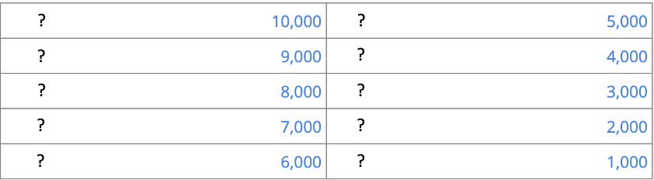
Top 10 queries
on Google starting with
Notes:
I want to start this talk with an interesting observation that how your daily interaction with today’s online platforms leak much more than you could have thought.
Let’s guess the top 10 search queries starting with “how do you get”.

Slide 3
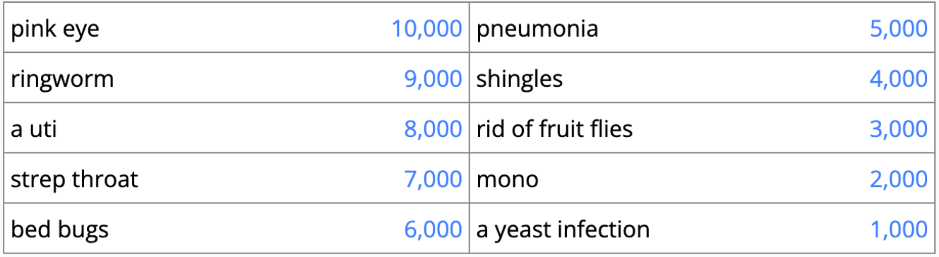
Top 10 queries
on Google starting with
Notes:
I played this game with a bunch of friends and many of them are very surprised by how sensitive these information are.
Our daily interaction with all kinds on databases leaks information, even if the database itself is public. This is because our query to the databases are revealed to the database operator, and that contains lots of personal information.

Slide 4


Private information retrieval (PIR) [CGKS95, KO97]
Encrypted search [Dory20]
Private search engine [Tiptoe23]
Database server has $x={\left\{0, 1\right\}}^{n}$
4 min
Secure password lookup [Checklist21]
Meta-data private messaging [Pung16]
Client wants to get the entry $x_{i}$
without revealing the index $i$
Notes:
Back in 30 years ago, cryptographers already started to think about this problem and they proposed a primitive as follows: the server holds ... the client has an index ...
If we have such … we can build many interesting applications by using PIR in a black box way.
[Talk about examples]
The efficiency of these applications rely on the efficiency of the underlying PIR protocols.
So the rest of the talk will discuss to how to build a good PIR protocol that realizes this primitive.

Slide 5
The trivial solution for PIR
Database server has $x={\left\{0, 1\right\}}^{n}$
Download the whole database
Client wants to get the entry $x_{i}$
without revealing the index $i$
Notes:
Although PIR sounds magic,
A trivial solution for PIR is that the
Perfect security: learn absolutely nothing
But this is not practical at all because real-world databases are large, namely n is large.
And in this case,
Communication n
Computation n – touch all bits
probe

Slide 6
An ideal picture of PIR
We want fast server computation (sublinear)
Database server has $x={\left\{0, 1\right\}}^{n}$
Query
Answer
We want small communication (sublinear)
Client wants to get the entry $x_{i}$
without revealing the index $i$
Notes:
Ideally, we would want the PIR protocol to have small cost.
server to do a small amount of computation, and gives back an answer that is short.

Slide 7
Background: PIR in two flavors
Information-theoretic
Computational
Secure against unbounded adversaries
Secure against poly-time adversaries
Single-server IT PIR is only possible when we allow $n$ bits of communication [CGKS95]
Notes:
The literature of constructing PIR diverged into two settings.
If we want to get perfect security with a single database, then we have to pay n bits of communication. That is, the trivial solution is the only solution.
So we need to relax the security or the model a little bit.

Slide 8
Background: PIR in two flavors
Information-theoretic
Computational
Secure against unbounded adversaries
Require database replication across multiple servers
Enforce non-collusion on servers
Secure against poly-time adversaries
Notes:
One direction sticks with perfect security, and their constructions copy the database over multiple servers, and to get privacy they need to have isolations between the servers. That is, no one can operate the two servers together.
[Say how the clients to the two server work]

Slide 9
Background: PIR in two flavors
Information-theoretic
Computational
Secure against unbounded adversaries
Require database replication across multiple servers
Enforce non-collusion on servers
Secure against poly-time adversaries
No database replication [KO97]
No need for non-colluding assumption
Notes:
The other direction consider a weaker security notion where the untrusted server is computationally bounded. And in such a setting, Kushilevitz and Ostrovsky show that there is no need to replicate the database, that is, we only have one database.
However, the computational constructions come at a price of performance.

Slide 10
Background: PIR in two flavors
Information-theoretic
Computational
Secure against unbounded adversaries
Require database replication across multiple servers
Enforce non-collusion on servers
Often efficient in practice (no cryptographic operations)
Secure against poly-time adversaries
No database replication [KO97]
No need for non-colluding assumption
Expensive server cost because of cryptogaphic operations
Notes:
They rely on hardness assumptions that usually have complicated “cryptographic” operations, the computational PIR are often significantly slower than the information-theoretic ones.
Tradeoff between system assumptions and efficiency

Slide 11
Theory land
Complexity
community
BF90
BFKR90
BIPW17 CHR17
This talk
Crypto
community
CGKS95
CG97, KO97
CMS99, Cha04, GR05, Lip05
BIKR02, Yek07, Efr09, DG15
BGI16
CK20, CHK22
LMW23
ISW24
IKLM24
Years
GIKLMR24
OnionPIR21 Spiral22
SimplePIR23 FrodoPIR23
HintlessPIR23, Piano24
Security
community
PPY18
Popcorn16
XPIR16
SEAL-PIR18
Dory20, Checklist21
Coeus21
Systems
community
Percy++ 14
Tiptoe23
Practice land
Notes:
BF90: Donald Beaver and Joan Feigenbaum. Hiding Instances in Multioracle Queries
BFKR90: Beaver, Feigenbaum, Kilian, Rogaway
29,54,31,79, 46
Lip05
Cha04
CMS99

Slide 12
Deployment considerations

Slide 13
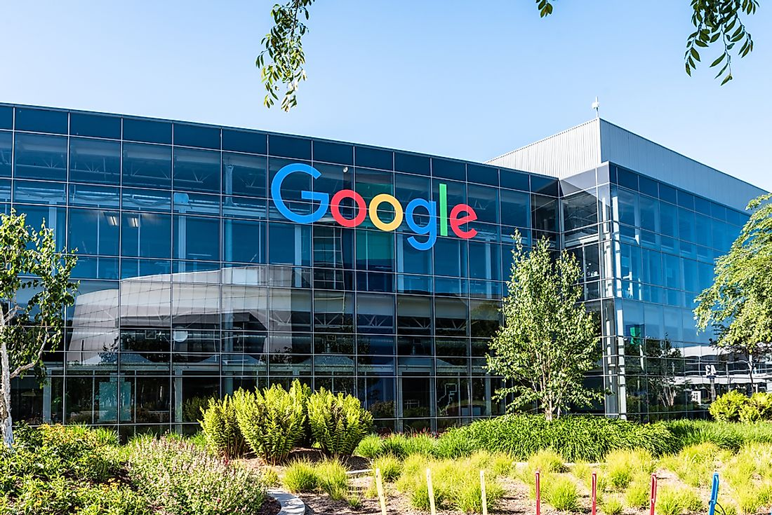

Deployment considerations
Information-theoretic
Computational
Require database replication across multiple servers
Enforce non-collusion on servers
No database replication [KO97]
No need for non-colluding assumption
Operational cost
Trust model
Notes:
Let’s say there is a large company like google who wants to use PIR.
Typically, they do not want to copy their database to some external platforms, because this introduces engineering overhead and cost for synchronizing the databases.
So they have to stick with the setting that only requires a single database.

Slide 14
Deployment considerations
Information-theoretic
Computational
Require database replication across multiple servers
Enforce non-collusion on servers
No database replication [KO97]
No need for non-colluding assumption
Operational cost
Trust model
Efficiency
Better
Is it affordable?
Notes:
But recall we just said that the computational protocols are slower. If we were to apply them in real-world application, what would be the cost?

Slide 15
Fastest PIR with a single database
Spiral [MW22]
1.3 request/sec
13 minutes
SimplePIR
[HHGMV23]
10.3 requests/sec
1 minute 40 seconds
100MB pre-download
100GB pre-download
1GB
1GB
Query
Answer
Query
Answer
A single client
1K clients
Notes:
Up to now, the fastest … roughly, 1 per second. If we are willing to afford some setup download, then we can improve to 10 requests per second by having the client download ....
In real world, google is not serving a single client. …
To user PIR,
We could naively have each client just run whatever algorithm it has in the single-server single-client model
Need more than 10 min,
or
The server has to communicate 100GB data to the clients.

Slide 16
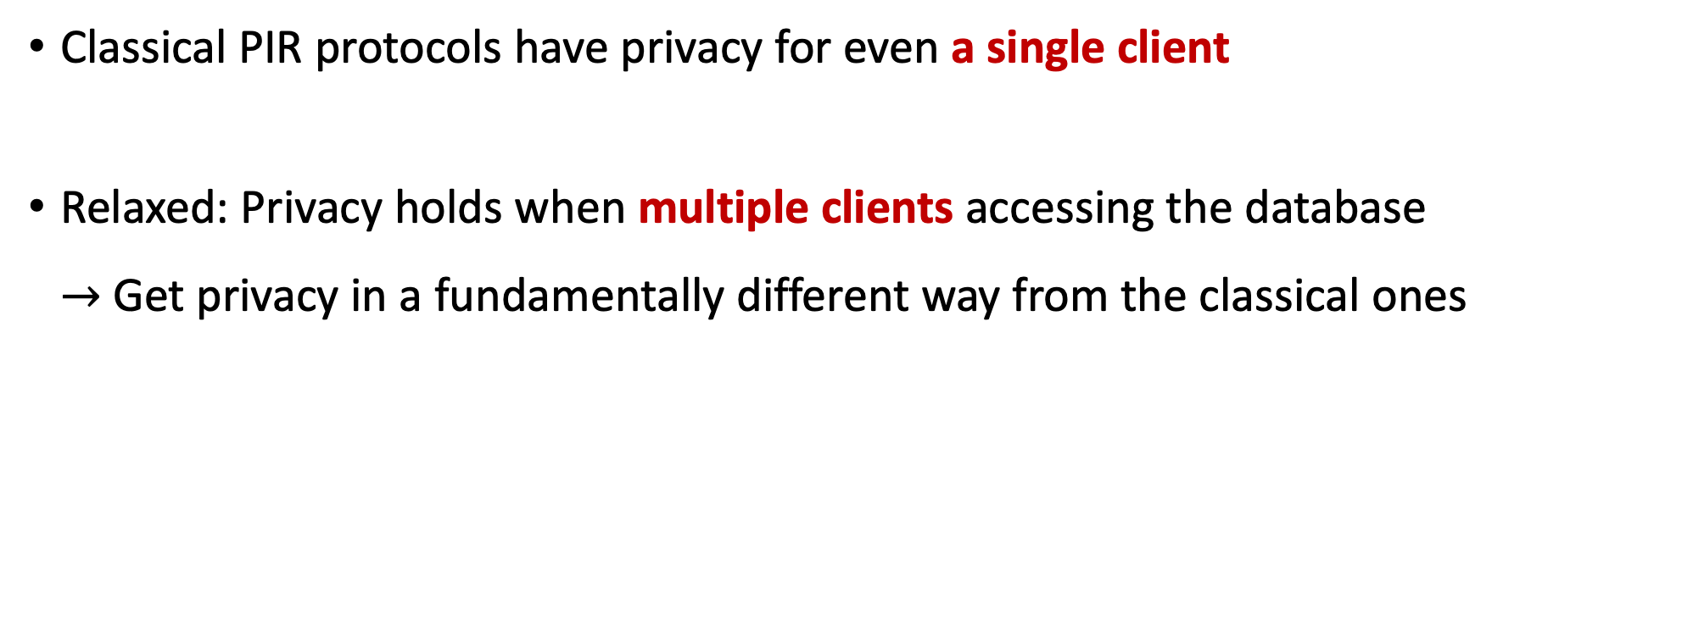
Utilizing the many clients
Classical PIR protocols have privacy for even a single client
Relaxed: Privacy holds when multiple clients accessing the database $→$ Get privacy in a fundamentally different way from the classical ones
7 min
Notes:
So, in this talk, we want to design PIR in some different way.
Classical PIR …
Here, we relax this guarantee…
Having multiple… is very reasonable to assume…
Fall back to…
This relaxation allows us to get privacy…

Slide 17
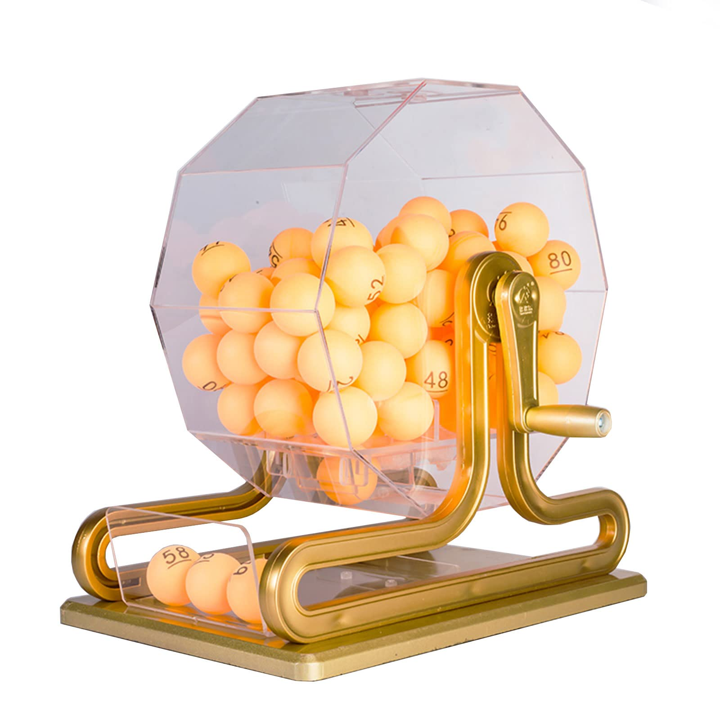









PIR in the shuffle model
Introducing a shuffler does not trivialize the PIR problem!
The shuffle model [IKOS06]
Component 1: Many clients make queries simultaneously
Component 2: The queries are shuffled before reaching the server
Popular in DP community: BEM⁺17, EFM⁺19, CSU⁺19, BBGN19, …
1 1 1
1 1 1
Notes:
The shuffle model
Ishai et al … secure computation context and later popular in ...
Two components.
Shuffler is semi-honest

Slide 18
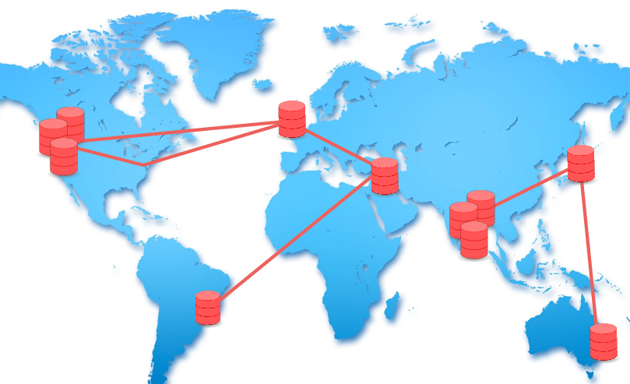
What do we gain from the shuffle model
Trust model
Security
Efficiency
“Single-server model”
IT is impossible
unless trivial download
13 min
“Two-server model”
Non-trivial IT
constructions exist
Part I [IKLM24]
The shuffle model
Non-trivial IT
constructions exist
An observer
Notes:
The trust model
as the classical two-server setting,
We have a database server, and a shuffle server, and they do not collude.
But we eliminate the need to copy the database and there is no storage overhead at the shuffler.
In practice, I want to say that this is better than the two-server trust model, because the shuffler can be run by any service independent of the database owner, so enforcing non-collusion is easier. And we can even distribute this shuffler as mixnet.

Slide 19
IT PIR in the shuffle model [IKLM24]
Single-server IT secure PIR with sublinear communication is theoretically feasible in the shuffle model.
Theorem (Informal).
For every $γ>0$, there is a single-server PIR in the shuffle model such that, on database size $n$, has $O(n^{γ})$ per-query communication and computation with $1/poly(n)$ statistical security (assuming one-time preprocessing), as long as $poly(n)$ clients simultaneously accessing the database.
Throughout this talk, we omit $polylog n$ factors.
Notes:
We give a class of protocols, generic construction
For every gamma, …
concrete parameters n^5 when \gamma=1/2
We also get exponential security with a slight sublinear communication.
Mention only table lookup

Slide 20
What do we gain from the shuffle model
Trust model
Security
Efficiency
1GB database
“Single-server model”
IT is impossible
unless trivial download
w/ prep. 10.3 req/sec
w/o prep. 1.3 req/sec
“Two-server model”
Non-trivial IT
constructions exist
w/ prep. 1000 req/sec
w/o prep. 11.8 req/sec
Part I [IKLM24]
Part II [GIKLMR24]
The shuffle model
Non-trivial IT
constructions exist
w/ prep. 117 req/sec
w/o prep. 3.3 req/sec
An observer
Notes:
Now let's get back to the benefits of shuffle model.
You can think that we have the same trust model as the classical two-server setting,
We have a database server, and a shuffle server, and they do not collude.
But we eliminate the need to copy the database and there is no storage overhead at the shuffler.
In practice, I want to say that this is better than the two-server trust model, because the shuffler can be run by any service independent of the database owner, so enforcing non-collusion is easier. And we can even distribute this shuffler as mixnet.

Slide 21
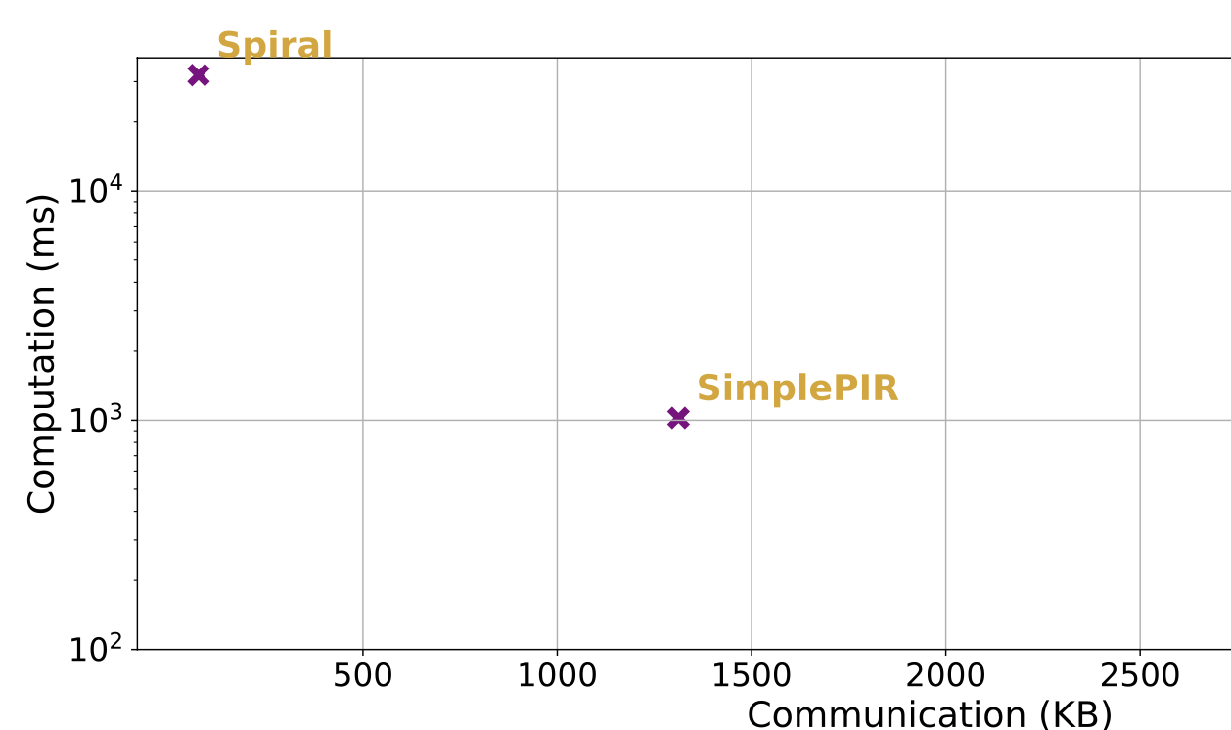
Computational PIR in the shuffle model [GIKLMR24]
8GB database: 2¹⁸ entries of 32KB (size of a pdf document of a few pages)
ShufflePIR
Non-private setting
Notes:
For a more realistic setting

Slide 22

Part I: Our information-theoretic construction
with Yuval Ishai, Mahimna Kelkar, Daniel Lee
A key tool: “Split and mix”
Construction idea: Inner-outer paradigm
An interesting orthogonal problem: Hiding record size without padding
Notes:
Now we will go to the technical part
Both our results use a powerful tool called split-and-mix.

Slide 23





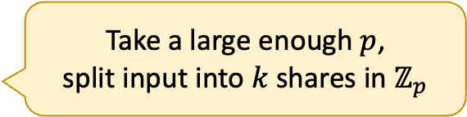
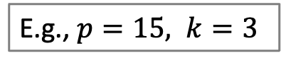
The split-and-mix paradigm [IKOS06]
A secure sum problem
Take a large enough $p$,
split input into $k$ shares in $ℤ_{p}$
2
1
0
3
4
1+1+0 2+13+1 9+3+3 4+14+0 6+3+10
E.g., $p=15, k=3$
Notes:
Each individual share reveals nothing

Slide 24
The split-and-mix paradigm [IKOS06]
A secure sum problem
2
1
0
3
4
1+1+0 2+13+1 9+3+3 4+14+0 6+3+10
E.g., $p=15, k=3$

Slide 25
The split-and-mix paradigm [IKOS06]
A secure sum problem
2
1
0
3
4
9+2+13 4+0+1 6+0+3 1+10+3 1+3+14
E.g., $p=15, k=3$
Notes:
The server adds the shares together and get the sum.
For the PIR problem, we will just use the privacy from the shuffling and we are not concerned with getting a sum result.

Slide 26
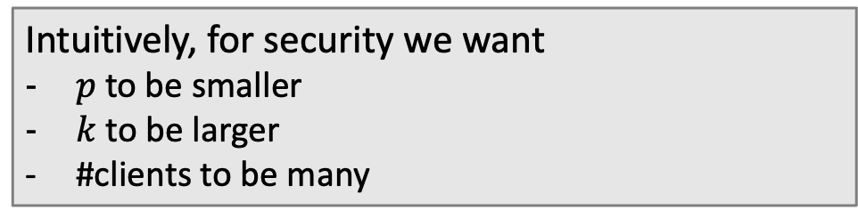
The split-and-mix paradigm [IKOS06]
A secure sum problem
2
1
0
3
4
9+2+13 4+0+1 6+0+3 1+10+3 1+3+14
E.g., $p=15, k=3$
Intuitively, for security we want
$p$ to be smaller
$k$ to be larger
#clients to be many
Notes:
You can fix some and adjust the other
For efficiency we want something opposite: …

Slide 27
Part I: Our information-theoretic construction
A key tool: “Split and mix”
Construction idea: Inner-outer PIR
An interesting orthogonal problem: Hiding record size without padding
Notes:
Now we will go to the technical part
Both our results use a powerful tool called split-and-mix.

Slide 28
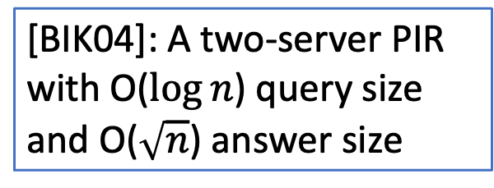
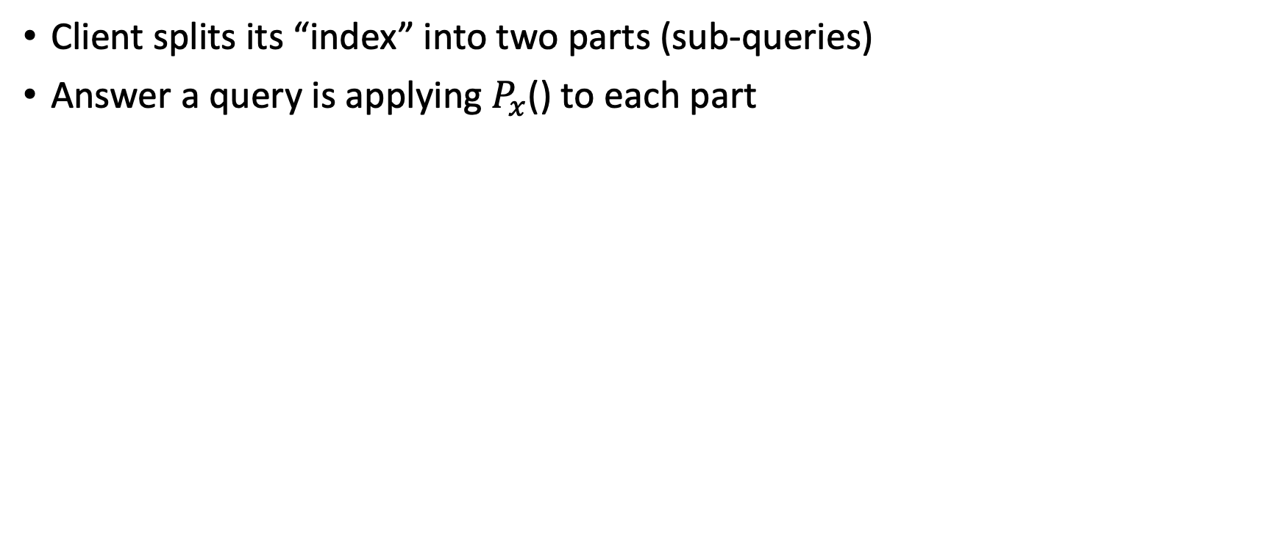
How multi-server PIR works
Client splits its “index” into two parts (sub-queries)
Answer a query is applying $P_{x}$() to each part
[BIK04]: A two-server PIR with O($\log{n}$) query size
and O($\sqrt{n}$) answer size
$$i∈[n]$$
$$q_{1}$$
$$q_{2}$$
$$a_{1}$$
$$a_{2}$$
$${a_{1}←P}_{x}(q_{1})$$
$${a_{2}←P}_{x}(q_{2})$$
$$x={\left\{0, 1\right\}}^{n}$$
$$x={\left\{0, 1\right\}}^{n}$$
Notes:
Mention P_x and reconstruct a

Slide 29

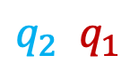
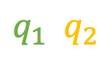
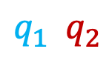
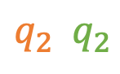
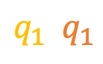
Shuffling PIR sub-queries
$i i i i i$
PIR sub-queries as additive shares
$$q_{1} q_{2}$$
$$q_{1} q_{2}$$
$$q_{1} q_{2}$$
$$q_{1} q_{2}$$
$$q_{1} q_{2}$$
Answer to each share
$$q_{1} q_{2}$$
$$q_{2} q_{2}$$
$$q_{1} q_{2}$$
$$q_{2} q_{1}$$
$$q_{1} q_{1}$$
Notes:
Mention add a random noise to hide the sum

Slide 30
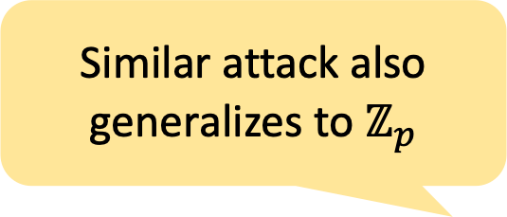
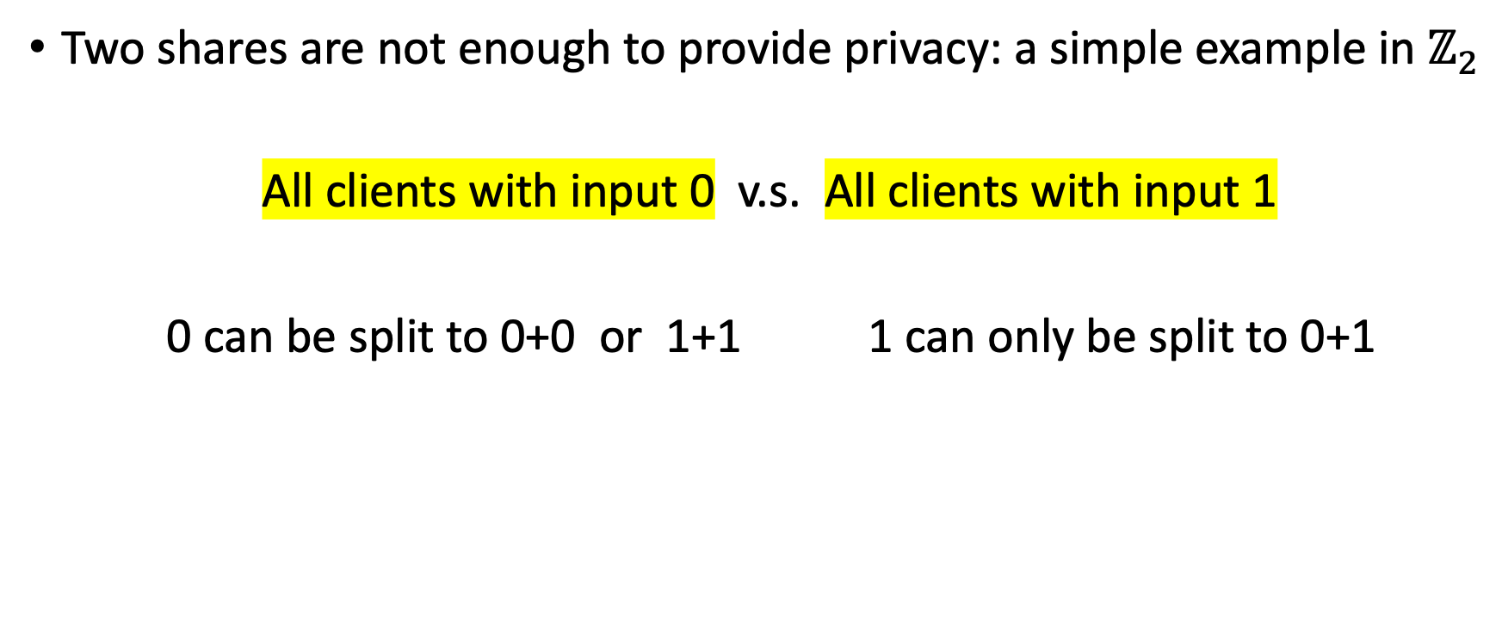
Are we done?
Similar attack also
generalizes to $ℤ_{p}$
Two shares are not enough to provide privacy: a simple example in $ℤ_{2}$
All clients with input 0 v.s. All clients with input 1
0 can be split to 0+0 or 1+1 1 can only be split to 0+1
Notes:
Even you have exponentially many clients

Slide 31
Our technique
Can we split to more shares in [BIK04]? Yes, but worse efficiency:
The $k$-server “additive PIR” has answer size $O(n^{\frac{k−1}{k}})$
Our technique:
Randomize the query index for the “additive PIR”
using an outer layer of PIR
Communication $O(n^{\frac{1}{2}} polylog(n))$
Notes:
So can we split into more shares to address the problem?
This is feasible, but it results in much worse communication cost.
Our key technique for is to randomize …. And this brings back the communication still to root n with to a polylog factor.
This works in 3 steps which I’ll show next.

Slide 32
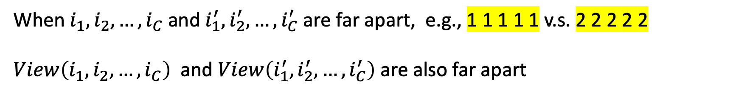
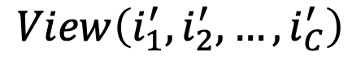
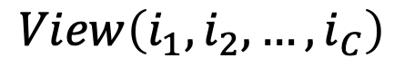
Step 1. Revisit the problem
$$i_{1} i_{2} … i_{C}$$
$$i_{1}^{′} i_{2}^{′} … i_{C}^{′}$$
$$View\left(i_{1},i_{2},…, i_{C}\right)$$
$$View\left(i_{1}^{′},i_{2}^{′},…, i_{C}^{′}\right)$$
When $i_{1}, i_{2}, …, i_{C}$ and $i_{1}^{′}, i_{2}^{′}, …, i_{C}^{′}$ are far apart, e.g., 1 1 1 1 1 v.s. 2 2 2 2 2
$View\left(i_{1}, i_{2}, …, i_{C}\right)$ and $View\left(i_{1}^{′}, i_{2}^{′}, …, i_{C}^{′}\right)$ are also far apart
Notes:
Recall the problem we faced in the two-share setting is: given a set of indices 1, …, 1 and 2, …, 2, if they are all different, then the distribution of the shares are also very different.

Slide 33
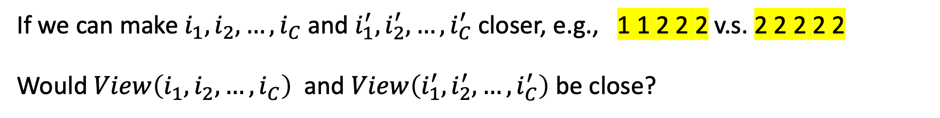
Step 2. Consider an optimistic case
$$i_{1} i_{2} … i_{C}$$
$$i_{1}^{′} i_{2}^{′} … i_{C}^{′}$$
1 1 1 1 1 v.s. 2 2 2 2 2
If we can make $i_{1}, i_{2}, …, i_{C}$ and $i_{1}^{′},i_{2}^{′}, …, i_{C}^{′}$ closer, e.g., 1 1 2 2 2 v.s. 2 2 2 2 2
Would $View\left(i_{1}, i_{2}, …, i_{C}\right)$ and $View\left(i_{1}^{′}, i_{2}^{′}, …, i_{C}^{′}\right)$ be close?
Notes:
Let’s step back a bit: if they are not that different, say we have C clients, and root of C clients are different, then after they split and we throw in some random numbers, the server cannot distinguish between the two.

Slide 34
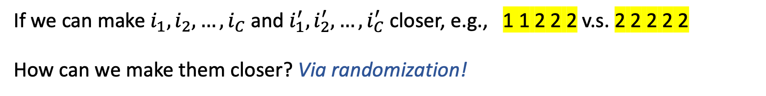
Step 3. How to reach the optimistic case
$$i_{1} i_{2} … i_{C}$$
$$i_{1}^{′} i_{2}^{′} … i_{C}^{′}$$
1 1 1 1 1 v.s. 2 2 2 2 2
If we can make $i_{1}, i_{2}, …, i_{C}$ and $i_{1}^{′},i_{2}^{′}, …, i_{C}^{′}$ closer, e.g., 1 1 2 2 2 v.s. 2 2 2 2 2
How can we make them closer? Via randomization!
Notes:
We cannot assume the client to query the random …
The challenge is that how to get correctness

Slide 35
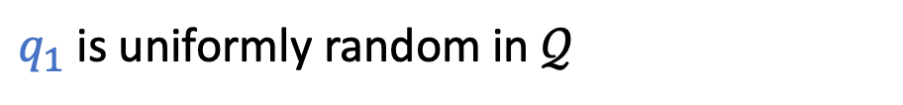
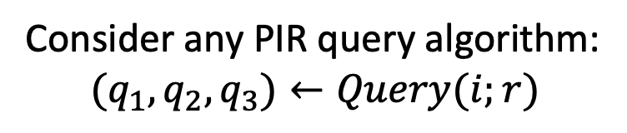
Randomizing query indices
How to randomize the indices?
$$i_{1}$$
$$i_{2}$$
$$i_{3}$$
$$∈[n]$$
An important observation
Consider any PIR query algorithm:
$$(q_{1},q_{2},q_{3})←Query(i;r)$$
$$q_{2}$$
Say $𝒬$ is the space that consists of all sub-queries
$$q_{1}$$
$$q_{3}$$
$q_{1}$is uniformly random in $𝒬$

Slide 36
General constructions: An “inner-outer” paradigm
How to randomize the indices?
$$i_{1}$$
$$i_{2}$$
$$i_{3}$$
$$∈[n]$$
Run outer PIR query algorithm
$$q_{1}$$
$$q_{2}$$
$$q_{3}$$
0001
$$q_{1}$$
$$q_{2}$$
$$q_{3}$$
$$∈𝒬$$
$$q_{1}$$
$$q_{2}$$
$$q_{3}$$
Interpret as indices
2
$$∈[n^{∗}]$$
$$i_{1}^{∗}$$
$$i_{2}^{∗}$$
$$i_{3}^{∗}$$
$$i_{1}^{∗}$$
$$i_{2}^{∗}$$
$$i_{3}^{∗}$$
$$i_{1}^{∗}$$
$$i_{2}^{∗}$$
$$i_{3}^{∗}$$
Build a database consisting of all possible answers in outer PIR
All answers
$$P_{x}(0000)$$
$$P_{x}(0001)$$
$$P_{x}(1111)$$
All sub-queries in $𝒬$
0000 0001 … 1111
$n^{∗}=|𝒬|$ indices
1 2 … $n^{∗}$
Notes:
Index i* is random now we split, OK.
the server build a database that stores the answers of all possible sub-queries.

Slide 37
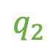

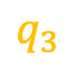
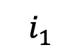
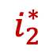
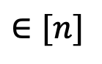
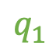
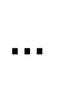
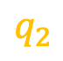
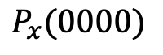

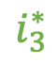
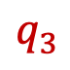
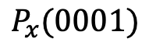
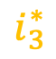
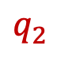
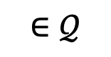
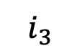

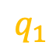
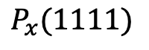
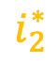


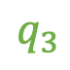
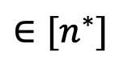
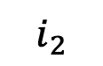
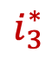
General constructions: An “inner-outer” paradigm
Recall: not secure if using
2-server BIM04 directly here
The outer layer:
any multi-server PIR
$$i_{1}$$
$$i_{2}$$
$$i_{3}$$
$$∈[n]$$
$$q_{1}$$
$$q_{2}$$
$$q_{3}$$
$$q_{1}$$
$$q_{2}$$
$$q_{3}$$
$$q_{1}$$
$$q_{2}$$
$$q_{3}$$
$$∈𝒬$$
$$i_{1}^{∗}$$
$$i_{2}^{∗}$$
$$i_{3}^{∗}$$
$$i_{1}^{∗}$$
$$i_{2}^{∗}$$
$$i_{3}^{∗}$$
$$i_{1}^{∗}$$
$$i_{2}^{∗}$$
$$i_{3}^{∗}$$
$$∈[n^{∗}]$$
The inner layer: 2-server BIM04
Shuffle inner PIR sub-queries
$$…$$
$$P_{x}(0000)$$
$$P_{x}(0001)$$
$$P_{x}(1111)$$

Slide 38
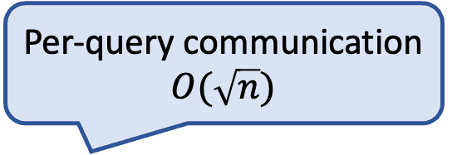
Complexity
Per-query communication $O(\sqrt{n})$
The outer layer:
any multi-server PIR
$$i_{1}$$
$$i_{2}$$
$$i_{3}$$
$$∈[n]$$
$$q_{1}$$
$$q_{2}$$
$$q_{3}$$
$$q_{1}$$
$$q_{2}$$
$$q_{3}$$
$$q_{1}$$
$$q_{2}$$
$$q_{3}$$
$$∈𝒬$$
$$i_{1}^{∗}$$
$$i_{2}^{∗}$$
$$i_{3}^{∗}$$
$$i_{1}^{∗}$$
$$i_{2}^{∗}$$
$$i_{3}^{∗}$$
$$i_{1}^{∗}$$
$$i_{2}^{∗}$$
$$i_{3}^{∗}$$
$$∈[n^{∗}]$$
The inner layer: 2-server BIM04
Shuffle inner PIR sub-queries
$$…$$
$$P_{x}(0000)$$
$$P_{x}(0001)$$
$$P_{x}(1111)$$

Slide 39

Complexity
Per-query communication $O(n^{γ})$ for any constant $γ$
The outer layer:
any multi-server PIR
$$i_{1}$$
$$i_{2}$$
$$i_{3}$$
$$∈[n]$$
$$q_{1}$$
$$q_{2}$$
$$q_{3}$$
$$q_{1}$$
$$q_{2}$$
$$q_{3}$$
$$q_{1}$$
$$q_{2}$$
$$q_{3}$$
$$∈𝒬$$
$$i_{1}^{∗}$$
$$i_{2}^{∗}$$
$$i_{3}^{∗}$$
$$i_{1}^{∗}$$
$$i_{2}^{∗}$$
$$i_{3}^{∗}$$
$$i_{1}^{∗}$$
$$i_{2}^{∗}$$
$$i_{3}^{∗}$$
$$∈[n^{∗}]$$
The inner layer: “CNF-PIR” [BIK04]
Shuffle inner PIR sub-queries
$$…$$
$$P_{x}(0000)$$
$$P_{x}(0001)$$
$$P_{x}(1111)$$

Slide 40

General constructions: An “inner-outer” paradigm
Theorem (Informal).
For every constant $γ$, there exists a PIR protocol in the shuffle model that, on any database size $n$,
per-query communication and computation $O\left(n^{γ}\right)$,
server storage $O\left(n^{1+γ}\right),$
assuming $O(n^{\left\{1+\frac{4}{γ}\right\}})$ simultaneous queries, and one-time preprocessing at the server.
Notes:
Present it in a compiler way
If we plug in the previous two-server additive PIR scheme by Beimel et al. then we get a PIR scheme in the shuffle model with root n communication.
With fancier inner PIR, we can reduce the communication to n^\gamma, but assuming more clients querying at the same time.
We also get negligible security $O(1/n^{\log{n}})$ with slightly sublinear communication $O(\frac{n}{\log{n}})$

Slide 41
Part I: PIR in the shuffle model
A key tool: “Split and mix”
Construction idea: Inner-outer PIR
An interesting orthogonal problem: Hiding record size without padding
Skip for now!
Notes:
Database entries have same size

Slide 42
Part II: Our computational construction
“Split and mix” under the computational setting
A simple construction
Performance

Slide 43
Revisit the security of split-and-mix
$$≈$$
Prior works only study statistical security [IKOS06, GMPV20, BBGN20]
$View$(1, 1, 1, 1, 1)
$View$(5, 0, 0, 0, 0)
#Clients | 100 | 1000 | 10000
#Shares $k$ (IT. 40 bits) | 6317 | 3856 | 2775
Each client input: a vector${ 2}^{15} × 𝔽_{2}$
Notes:
Prior study on split-and-mix was almost entirely restricted to information-theoretic security.
In other words, they choose the number of shares k so that the two views look close to an unbounded adversary.
Concretely, to guarantee a statistical distance 2^{-40}, we need k to be a few thousands.

Slide 44
New: computational security for split-and-mix
Strengthen that I’m moving to our work
$$≈$$
Prior works only study statistical security [IKOS06, GMPV20, BBGN20]
This work studies computational security, aiming to reduce the #shares $k$ (and hence improving concrete efficiency)
$View$(1, 1, 1, 1, 1)
$View$(5, 0, 0, 0, 0)
#Clients | 100 | 1000 | 10000
#Shares $k$ (IT. 40 bits) | 6317 | 3856 | 2775
#Shares $k$ (Comp. 128 bits) | 405 | 88 | 37
Each client input: a vector${ 2}^{15} × 𝔽_{2}$
Notes:
This work studies computational security for split-and-mix, with the insight being that the parameter k can be reduced if we only need to guarantee the two views look close to a computationally bounded adversary.
To guarantee 128 bits of computational security, the required k is much smaller. In other words, the communication cost can be greatly improved.

Slide 45

Our results from computational split-and-mix
Computational security for split-and-mix based on SD, MDSD
Single-server secure aggregation in the shuffle model
Single-server PIR
in the shuffle model
Up to 25X savings for communication compared to the best statistical split-and-mix baseline
Up to 22X improvement of throughput (in the batch setting) over SimplePIR [HHCMV23] with comparable communication cost
(Even giving advantage to the baseline by compressing the shares)
Notes:
With the computational notion for split-and-mix, together with a bunch of other optimizations, we get a PIR protocol up to 22X improvement of throughput over SimplePIR which is the fastest PIR in the standard model.
Also I want to mention we get a secure aggregation protocol with up to 25X improvement for communication over the best baseline in the statistical setting. This is even when we give advantage of the baseline by compress shares using PRG.
But in this talk, I’ll focus on PIR.

Slide 46


Starting point: a classic multi-server PIR
Query vector $v$
0
0
1
0
Shorten this
$$q_{1}$$
$$q_{2}$$
$$q_{k}$$
$$a_{k}$$
$$a_{1}$$
$$a_{2}$$
Database $D$ of size $n$;
$\sqrt{n}$ by $\sqrt{n}$ matrix
$$…$$
$$v⋅D=\left(q_{1}+…+q_{k}\right)⋅D$$ $=q_{1}⋅D+…+q_{k}⋅D$
$≔a_{1}+…+a_{k}$
Notes:
Now, we can use a simple multi-server PIR together with split and mix.

Slide 47

Split-and-mix based on Syndrome Decoding (SD)
The SD assumption (dual-LPN [BFKL94, AIK07]) $H$: a random matrix $y$: a target vector (e.g., a client’s input)
Computationally hard to find low-weight vector $e$ such that $H⋅e=y$
$$H$$
$$y$$
Notes:
The computation assumption we will use is called SD.
The syndrome decoding problem can be succinctly described as follows: given a random matrix H, and a target vector y, we are asked to find a few columns in H such that these columns add up to y. For some dimensions of H, this problem is computationally hard.
So how does this relate to split-and-mix? Let's assume for a second, we have only one client and this client’s shares are mixed with a bunch of random stuff. Then from SD, we can claim that the server cannot identify this client’s share from H.

Slide 48
Split-and-mix based on Syndrome Decoding (SD)
The positions of 1 in E’s columns are disjoint
“Multi-Disjoint” Syndrome Decoding $H$: a random matrix $Y=[y_{1},y_{2},…]$: multiple target vectors (e.g., multiple client inputs)
Be clear that this is a complexity assumption
Computationally hard to find “low-weight” $E$ such that $H⋅E=Y$
$$H$$
$$y_{1}$$
$$y_{2}$$
We generalize SD to
Multi-Disjoint Syndrome Decoding
to handle multiple clients
Notes:
We generalize this assumption to multi-disjoint syndrome decoding, namely, it is computationally hard to find multiple subsets of columns, where each subset of columns sum up to a target vector.

Slide 49
Single-server computationally PIR from split-and-mix
…
$$v_{1}$$
$$v_{2}$$
$$v_{c}$$
A share vector
Notes:
Note: no inner-outer paradigm here, just one PIR scheme

Slide 50
Single-server computationally PIR from split-and-mix
…
…
$$\left\langle D, \right\rangle =$$
Notes:
To this end, we need to additionally assume the global shuffler abstracts a two-way anonymous channel, namely it can inversely permute the shares.
So the server will process each share by computing the inner product with the database, one by one.
Then the shuffler permutes back and forward the answers to the client.

Slide 51
Single-server computationally PIR from split-and-mix
…
$$a$$
$$a$$
$$a$$
…
Notes:
Finally each client can reconstruct the database column it wants by adding up the answers.

Slide 52

Performance
8GB database, large records (2¹⁸ entries of 32KB)
Left bottom is better
Assuming 100K or 1K clients query at the same time
Assuming 100K or 1K clients query at the same time
Notes:
This figure shows the server computation and communication per client query. What we would like is small computation and small communication, that is the bottom left of the graph.
ShufflePIR is our protocol. And it outperforms the recent PIR works. A tradeoff is that the security is guaranteed only when many clients making queries at the same time, here we show the datapoint for 1K and 100K. The more clients are, the better the communication is.

Slide 53




Discussion
Two database servers vs. one database server + shuffler
Easier to enforce
No storage overhead
Notes:
Two databases in the same trust domain

Slide 54
Discussion
We are in the situation of exploiting tradeoffs: making assumptions, relaxing security, etc.
Meanwhile, guaranteeing different assumptions does not require the same amount of effort: system efforts, law efforts, etc.
The likelihood of assumptions being compromised in real-world scenarios may vary

Slide 55
Part I recap: Our information-theoretic construction
A key tool: “Split and mix”
Construction idea: Inner-outer PIR
An interesting orthogonal problem: Hiding record size without padding
We can get to this now
Notes:
Finally, we show that this shuffle model can be used to avoiding padding in PIR.
We will skip this part due to time limit, and we can get back to this in Q&A if anyone is interested.

Slide 56

PIR with variable-sized records
To deploy PIR in real-world applications…
Often assume the same size, mostly ${\left\{0, 1\right\}}^{n}$
They have different lengths
Database entries of PIR in theory
Database records in practice
Notes:
The usual way to do hide the record size is to pad all of the records to the length of maximum record in the database

Slide 57
PIR with variable-sized records
To deploy PIR in real-world applications…
Often assume the same size, mostly ${\left\{0, 1\right\}}^{n}$
They have different lengths
Database entries of PIR in theory
Database records in practice
To retrieve privately, it is necessary to hide record size
Notes:
The usual way to do hide the record size is to pad all of the records to the length of maximum record in the database

Slide 58



PIR with variable-sized records
Padding solves the problem: how about efficiency?
Features
Database records in practice
The discrepancy between the smallest and the largest record can be huge
Majority of the records are small
Most users access the small records much more often than the large records

Slide 59
PIR with variable-sized records
Waste of server storage
(though can virtually store)
Padding solves the problem: how about efficiency?
Client who retrieves the small record has to pay the cost of retrieving the largest record
Features
Database records in practice
The discrepancy between the smallest and the largest record can be huge
Majority of the records are small
Most users access the small records much more often than the large records

Slide 60
PIR with variable-sized records
In the “standard” model, there is no way out
In the shuffle model: yes, we can
No server storage overhead
Client communication proportional to the length of the retrieved record
Leak only the total size of all queried records
Notes:
Change the notation
How does the client get the length of the item: need to explain

Slide 61


PIR with variable-sized records
A toy protocol
$T$ database records
Concatenate
An $n$-bit database
Notes:
Change the notation
How does the client get the length of the item: need to explain

Slide 62

PIR with variable-sized records
A toy protocol
$T$ database records
Concatenate
Query a size-$ℓ$ record:
Make $ℓ$ PIR queries,
each for one bit
An $n$-bit database

Slide 63

PIR with variable-sized records
A toy protocol
No server storage overhead
$T$ database records
Concatenate
Query a size-$ℓ$ record:
Make $ℓ$ PIR queries,
each for one bit
An $n$-bit database
Communication is proportional to the queried length instead of the maximum length

Slide 64


PIR with variable-sized records
A toy protocol
No server storage overhead
Can we do better?
Yes, from $ℓ$ PIR queries to $polylogℓ$PIR queries
$T$ database records
Concatenate
Query a size-$ℓ$ record:
Make $ℓ$ PIR queries,
each for one bit
An $n$-bit database
Communication is proportional to the queried length instead of the maximum length

Slide 65
PIR with variable-sized records
Revisit the toy protocol
$T$ database records
Why not retrieve more bits
in each PIR query?
Concatenate
Query a size-$ℓ$ record:
Make $ℓ$ PIR queries,
each for one bit
An $n$-bit database

Slide 66


PIR with variable-sized records
Splitting records to the powers of two
The $n$-bits concatenated database
Secure or not?
Deterministic splitting is not secure
(unless split down to 1)
Server (logically) preprare $\log{n}$ databases:
the $j$-th database is partitioned to $2^{j}$bits per entry

Slide 67

PIR with variable-sized records
Splitting records to the powers of two
Consider 5 1 1 1 v.s. 2 2 2 2
Server (logically) preprare $\log{n}$ databases:
the $j$-th database is partitioned to $2^{j}$-bit per entry

Slide 68
PIR with variable-sized records
Our approach: recursive splitting
The $n$-bits concatenated database
Head: stay
Tail: split
For each block, toss a coin
Server (logically) preprare $\log{n}$ databases:
the $j$-th database is partitioned to $2^{j}$-bit per entry

Slide 69
PIR with variable-sized records
Our approach: recursive splitting
The $n$-bits concatenated database
Head: stay
Tail: split
For each block, toss a coin
Server (logically) preprare $\log{n}$ databases:
the $j$-th database is partitioned to $2^{j}$-bit per entry

Slide 70
PIR with variable-sized records
Our approach: recursive splitting
The $n$-bits concatenated database
Head: stay
Tail: split
For each block, toss a coin
Server (logically) preprare $\log{n}$ databases:
the $j$-th database is partitioned to $2^{j}$-bit per entry

Slide 71
PIR with variable-sized records
Our approach: recursive splitting
The $n$-bits concatenated database
Head: stay
Tail: split
For each block, toss a coin
Server (logically) preprare $\log{n}$ databases:
the $j$-th database is partitioned to $2^{j}$-bit per entry

Slide 72
PIR with variable-sized records
Our approach: recursive splitting
The $n$-bits concatenated database
Head: stay
Tail: split
For each block, toss a coin
The final blocks that the client will retrieve (using PIR)
Server (logically) preprare $\log{n}$ databases:
the $j$-th database is partitioned to $2^{j}$-bit per entry

Slide 73


PIR with variable-sized records
A complication of recursive splitting: fully split the highest $log C$ levels
Consider 5 1 1 1 v.s. 2 2 2 2
With $1/2$ probability, there will be a block
Server (logically) preprare $\log{n}$ databases:
the $j$-th database is partitioned to $2^{j}$-bit per entry

Slide 74
PIR with variable-sized records
A complication of recursive splitting: fully split the highest $log C$ levels
Consider M-3 1 1 1 v.s. M/4 M/4 M/4 M/4
With $1/2$ probability, there will be a block
Server (logically) preprare $\log{n}$ databases:
the $j$-th database is partitioned to $2^{j}$-bit per entry

Slide 75

PIR with variable-sized records
A complication of recursive splitting: fully split the highest $log C$ levels
Consider M-3 1 1 1 v.s. M/4 M/4 M/4 M/4
As long as there are sufficient number of blocks at this level

Slide 76







PIR with variable-sized records
Splitting records to the power of two
The largest block $≥$ maximum record size/2
The multi-set of record lengths from all clients will not leak any individual queried length
$$=$$
$$+$$
$$+$$
$$=$$
$$+$$

